Slide 1
DECLARATION
I hereby declare that the project work entitled “Online Voting System”, submitted as part of the evaluation for the
subject Database Management System in the 4th semester of
the Bachelor of Technology in Computer Engineering, is an authentic record of my own work, carried out under the supervision
of Prof. .
This project report has not been submitted, either wholly or in part, for any course or degree at this or any other institute/university.
Anurag Bhatt
SUPERVISOR CERTIFICATE
To the best of my knowledge, the report titled “Online Voting System” is based on original work completed by the students as part of their 4th semester curriculum for the subject Database Management System. This work has not been submitted elsewhere for any course or degree, in part or full, as per the student’s declaration.
Place: New Delhi Date:
(Supervisor)

Slide 2

Online Voting System
DBMS (CS 210n)

Slide 3
CONTENTS
Synopsis
Introduction
Technical Requirements
Schemas
Entity-Relationship (ER) Diagram
Transforming ER Diagram into Tables
SQL Queries & Implementation
Features of the Online Voting System
Conclusions
References

Slide 4
Synopsis
The Online Voting System's primary objective is to offer straightforward, safe, and easily accessible platform for digital election administration. By eliminating the need for voters to physically visit polling places and enabling registered users to cast their ballots online from any location, this project seeks to streamline the voting process. Students, working people, and anybody else who is unable to be physically present during elections will find it especially helpful.
Users can register using this system by providing their voter and personal information, which is safely kept in a database. After logging in, they can vote for one candidate, view their dashboard, and see a list of candidates along with the names and symbols of their parties. To avoid duplicate voting, their status is changed to "Voted" after they have cast their ballot. Additionally, there’s also an admin panel where candidates can be added or managed, and all data is protected with login authentication to ensure privacy and security.

Slide 5
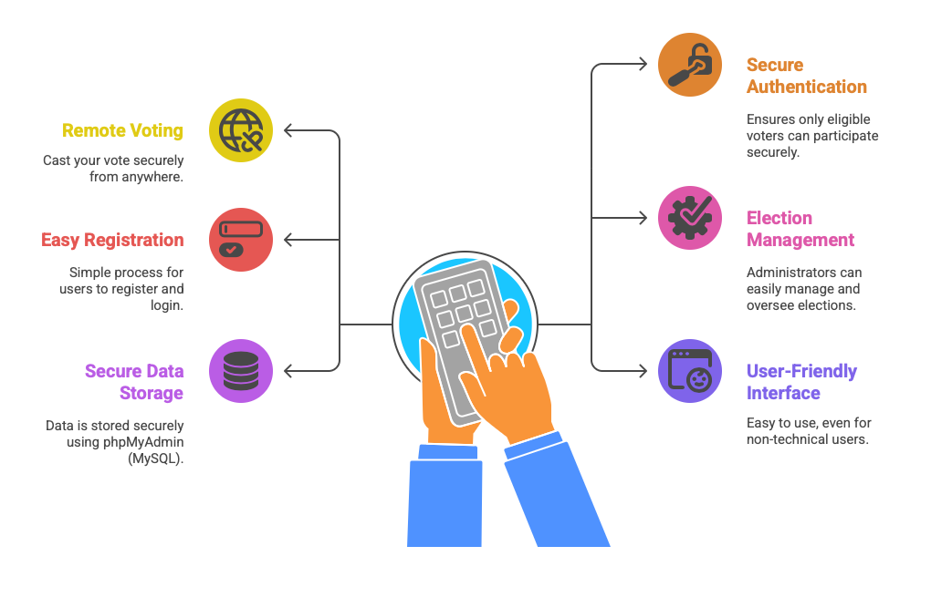
Introduction
Proposal for the Problem:
India's current voting system still relies mostly on traditional, offline methods. This often leads to long lines, delays, and a lot of confusion. Many people especially students, working professionals, and those living far from home end up missing their chance to vote because the process isn’t flexible. On top of that, manual vote counting can lead to errors, fake entries, and questions about the system’s transparency.
Proposed Solution: I propose an Online Voting System—a secure and user-friendly digital platform that enables registered users to vote remotely. The system features voter registration, a separate admin panel, and a voter dashboard. Each user is allowed to vote only once, with their status auto-updated post-voting..
Key Features of the Online Voting System:

Slide 6

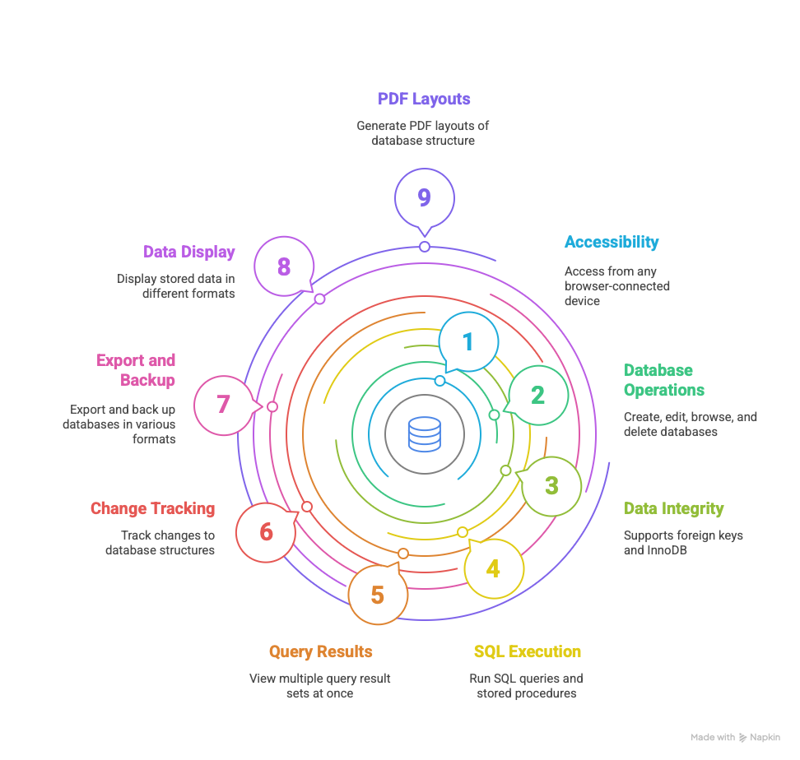
Technical Requirements
PhpMyAdmin:
phpMyAdmin is a user-friendly, browser-based tool for managing MySQL databases. It offers a graphical interface that simplifies database tasks, making it ideal for both beginners and experienced users.
Key Features of phpMyAdmin:

Slide 7

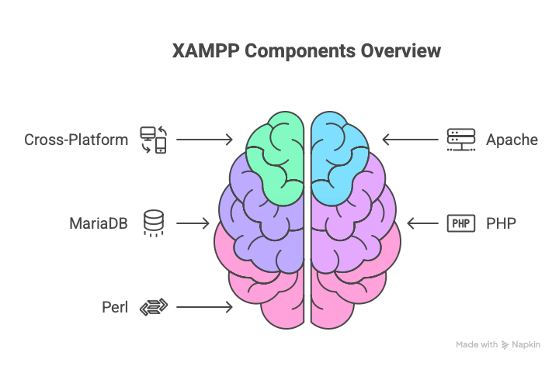
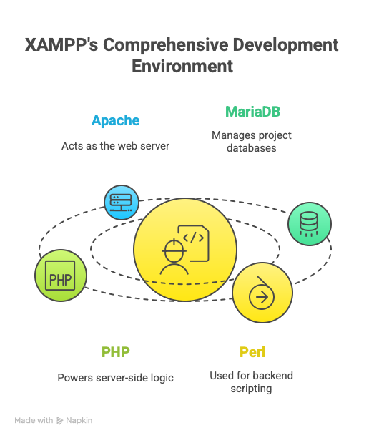
XAMPP:
XAMPP is a free and open-source software package that provides a local development environment for building and testing web applications. The name XAMPP stands for:
X – Cross-Platform (it works on Windows, macOS, and Linux)
A – Apache
M – MariaDB)
P – PHP
P – Perl

Slide 8

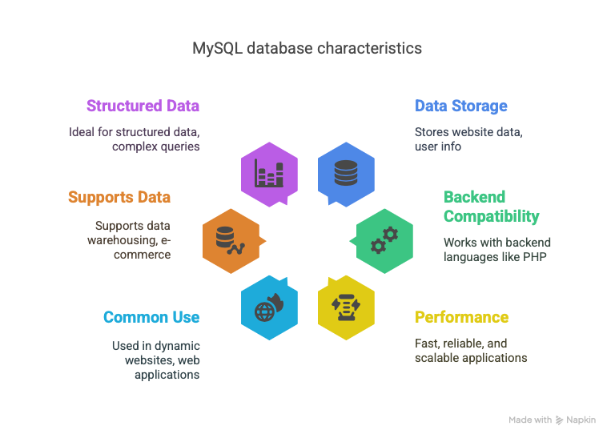

MySQL:
MySQL is a popular open-source RDBMS that uses SQL to store, organize, and retrieve data. It's widely used in web development for managing structured data efficiently and reliably.
HTML CSS:
The Hypertext Markup Language (HTML) is the standard markup language for documents designed to be displayed in a web browser. It can be assisted by technologies such as Cascading Style Sheets (CSS) and scripting languages such as JavaScript.

Slide 9
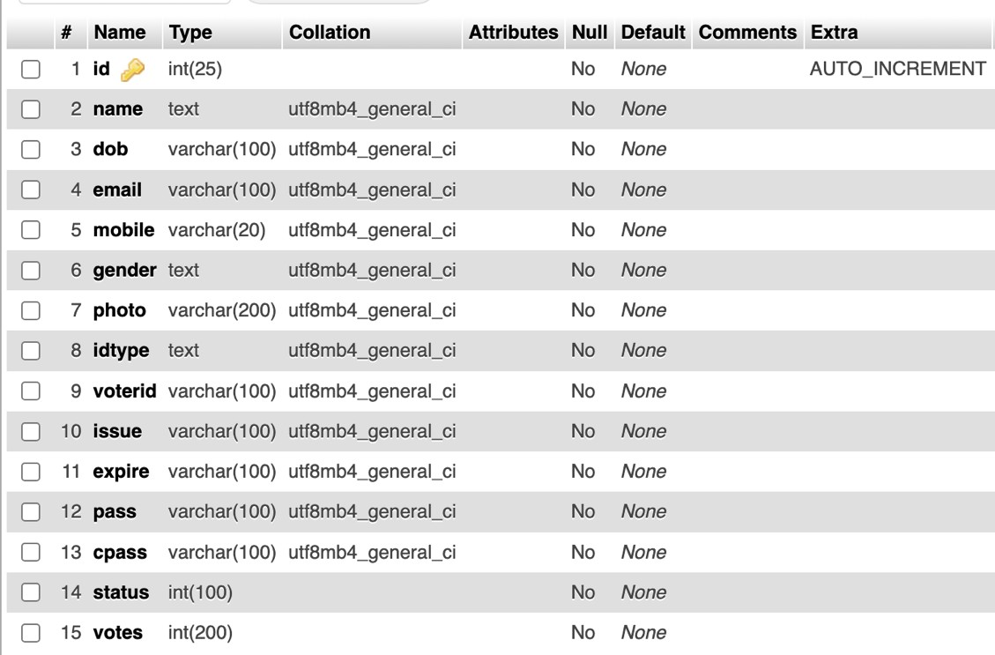
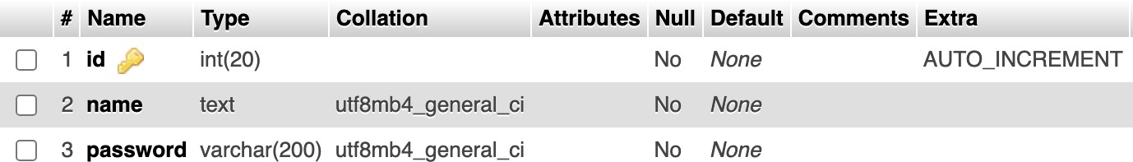
SCHEMAS
Voter Registration:
Admin Login:

Slide 10
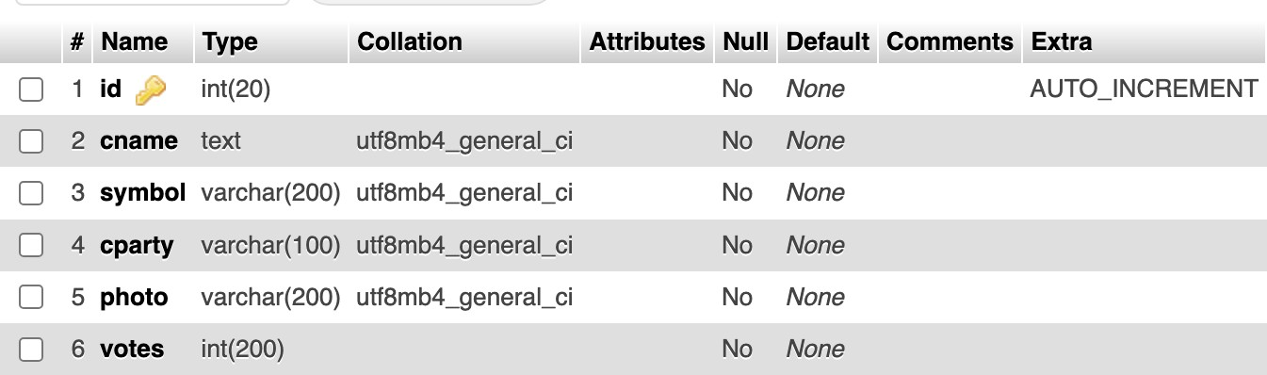
Add Candidate:

Slide 11
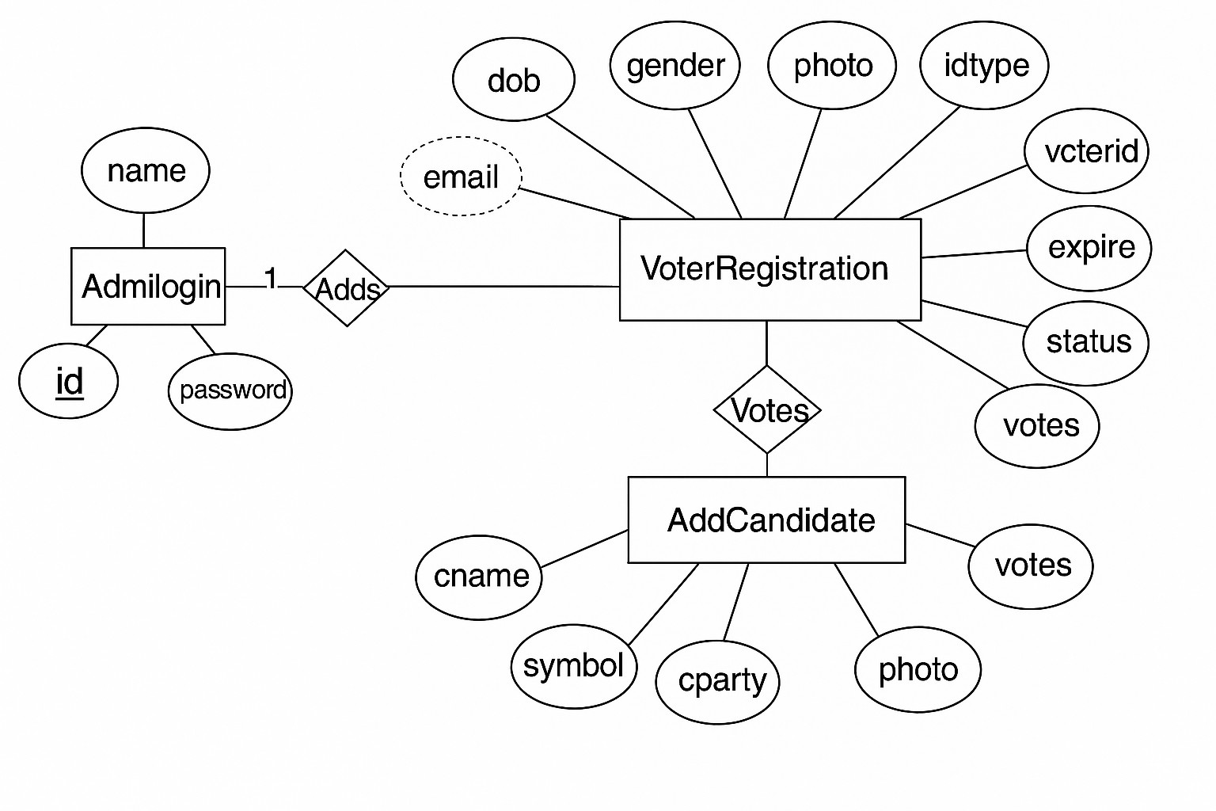
Entity-Relationship (ER) Diagram

Slide 12
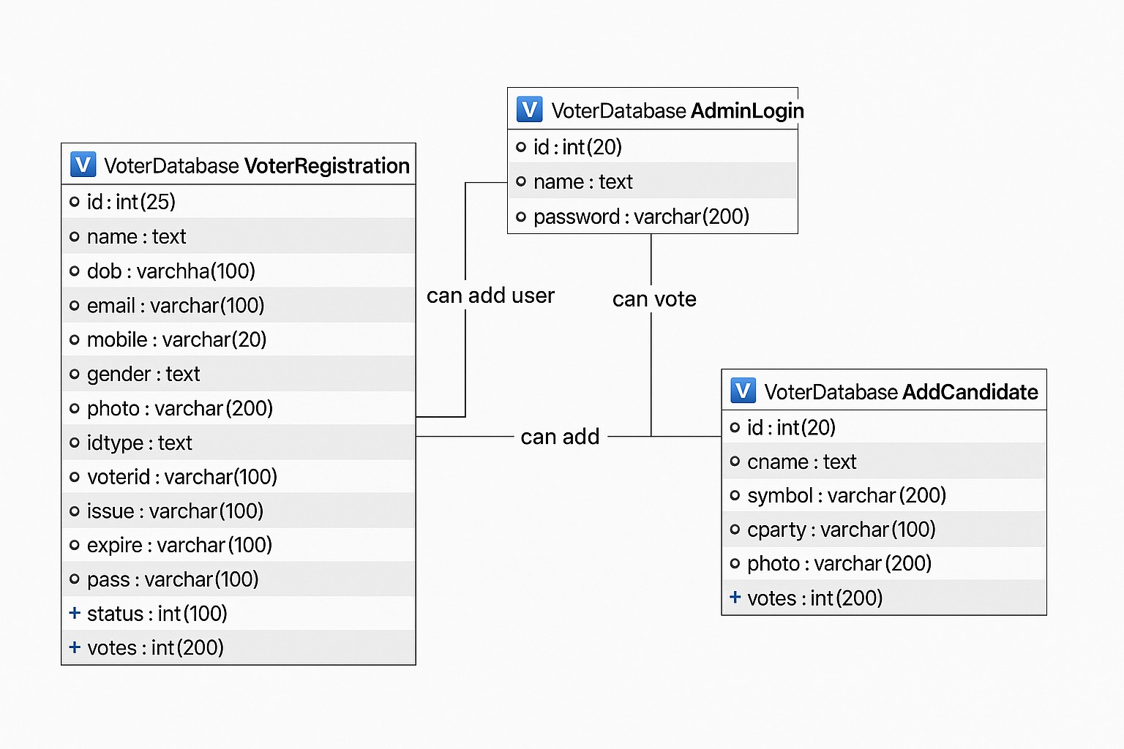
TRANSFORMING ER DIAGRAM INTO TABLES

Slide 13
SQL Queries & Implementation
Table 1: Add Candidate:
CREATE TABLE `AddCandidate` (
`id` int(20) NOT NULL,
`cname` text NOT NULL,
`symbol` varchar(200) NOT NULL,
`cparty` varchar(100) NOT NULL,
`photo` varchar(200) NOT NULL,
`votes` int(200) NOT NULL);
ALTER TABLE `AddCandidate` ADD PRIMARY KEY (`id`);
-
ALTER TABLE `AddCandidate`
MODIFY `id` int(20) NOT NULL AUTO_INCREMENT, AUTO_INCREMENT=18;

Slide 14
Table 2:Admin Login:
CREATE TABLE `AdminLogin` (
`id` int(20) NOT NULL,
`name` text NOT NULL,
`password` varchar(200) NOT NULL);
ALTER TABLE `AdminLogin` ADD PRIMARY KEY (`id`);
ALTER TABLE `AdminLogin`
MODIFY `id` int(20) NOT NULL AUTO_INCREMENT, AUTO_INCREMENT=3;
Table 3: Voter Registration:
CREATE TABLE `VoterRegistration` (
`id` int(25) NOT NULL,
`name` text NOT NULL,
`dob` varchar(100) NOT NULL,
`email` varchar(100) NOT NULL,
`mobile` varchar(20) NOT NULL,
`gender` text NOT NULL,
`photo` varchar(200) NOT NULL,
`idtype` text NOT NULL,

Slide 15
`voterid` varchar(100) NOT NULL,
`issue` varchar(100) NOT NULL,
`expire` varchar(100) NOT NULL,
`pass` varchar(100) NOT NULL,
`cpass` varchar(100) NOT NULL,
`status` int(100) NOT NULL,
`votes` int(200) NOT NULL);
ALTER TABLE `VoterRegistration` ADD PRIMARY KEY (`id`);
ALTER TABLE `VoterRegistration`
MODIFY `id` int(25) NOT NULL AUTO_INCREMENT, AUTO_INCREMENT=12;

Slide 16
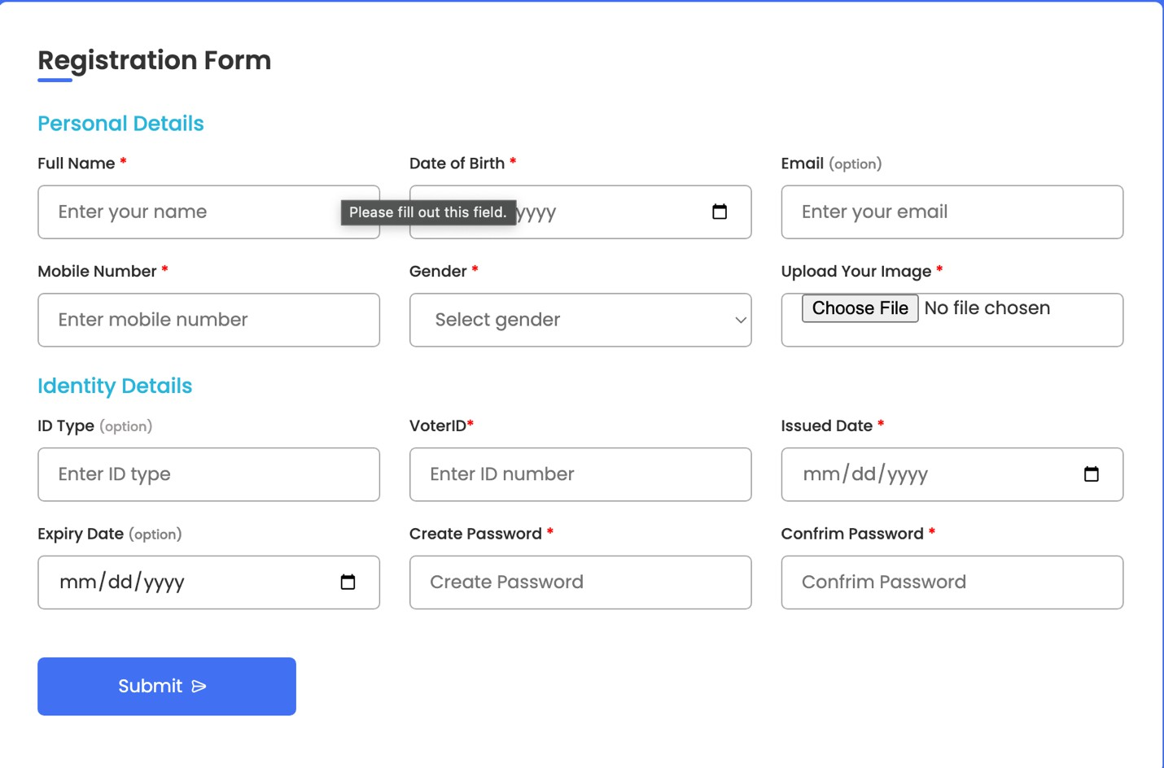
Features of the Online Voting System
Registration of New Voter:
New voters need to fill the registration form with correct and credible information.

Slide 17
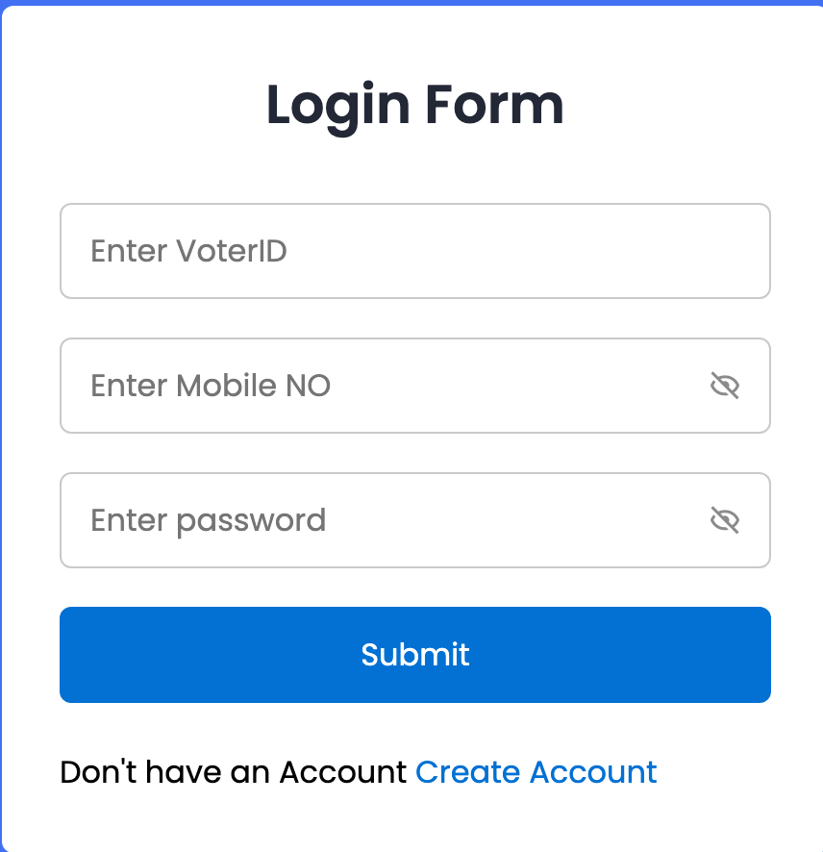
Voter login:
Once you register ,you will be redirected here. Here the voter can Login by entering voterID , mobile no, and Password.

Slide 18
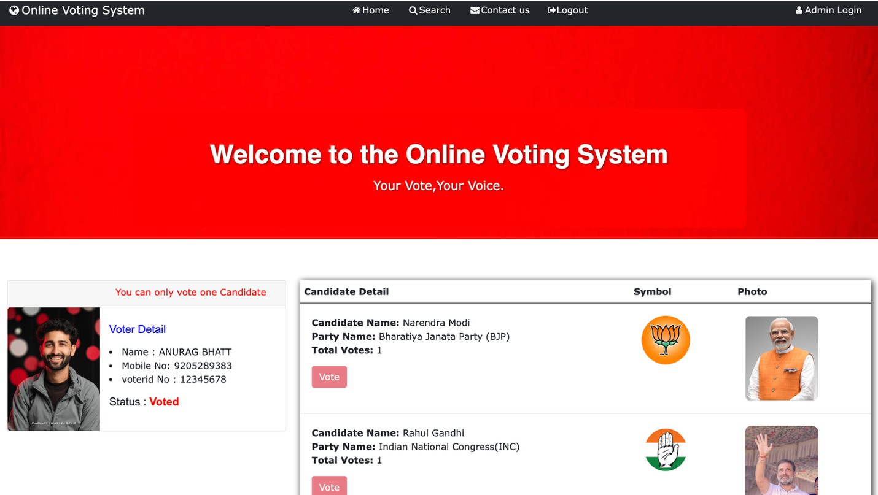
Homepage:
After you login, you will be redirected to the homepage .Here information about candidate and the voter will be displayed. The voter can vote the candidate. Also there is Admin panel for the registration of the candidate.

Slide 19
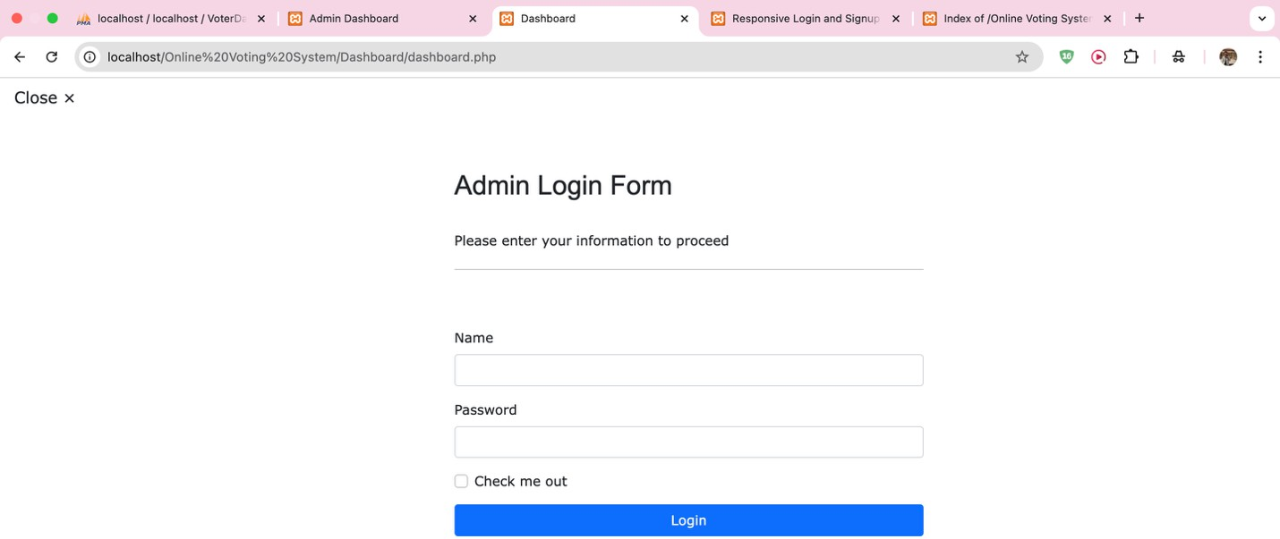
Admin Panel:
Here admin needs to enter name and password to go the admin dashboard where candidate can register.

Slide 20
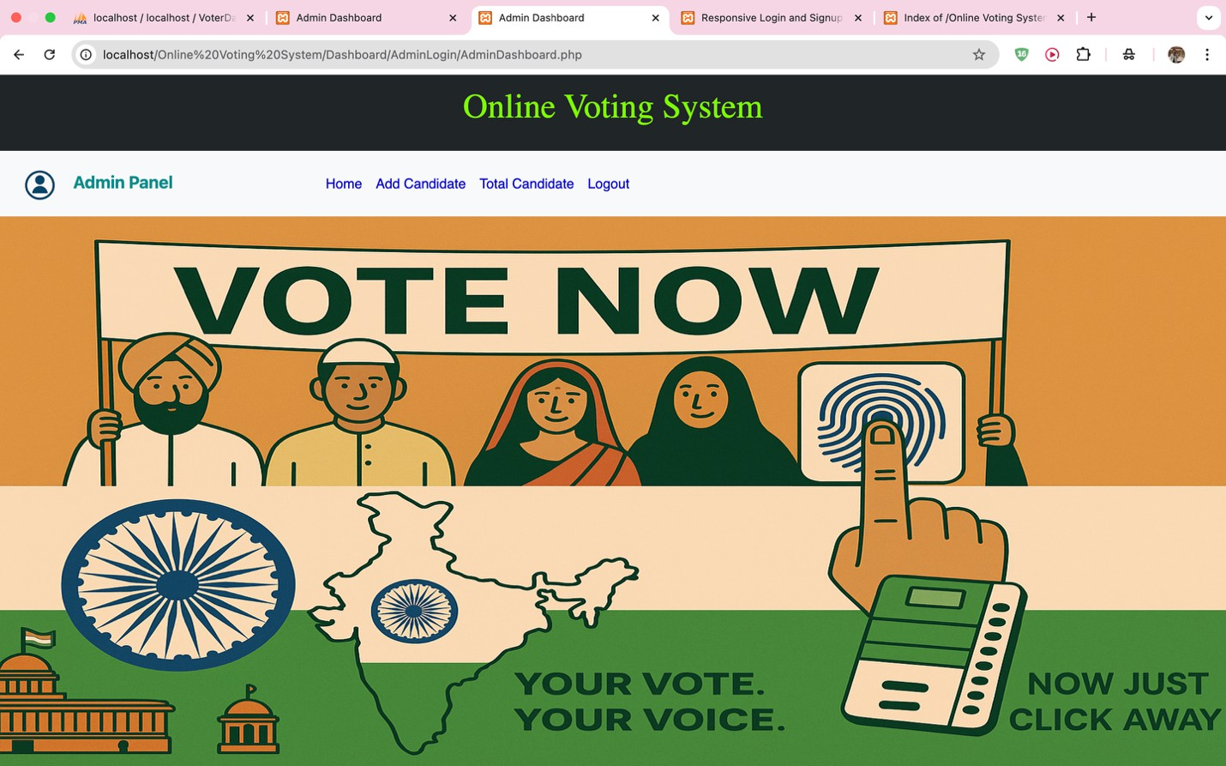
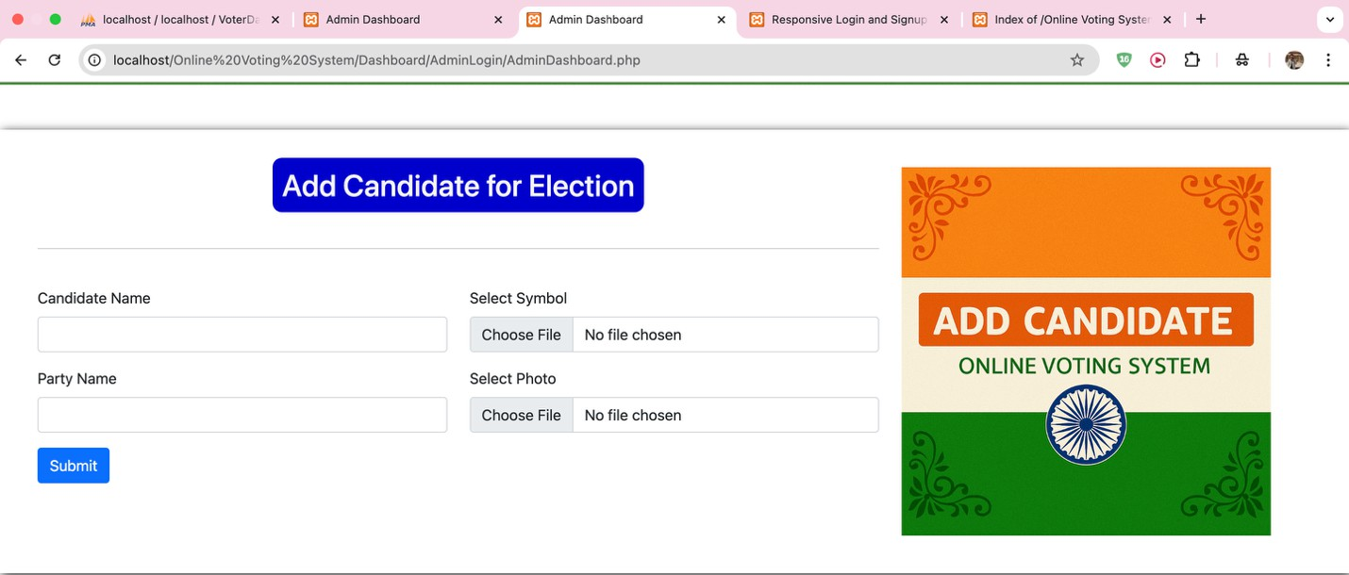
Homepage After filling Admin login form:
Candidate Registration:
Candidates willing to participate in the election can fill this form and officially register for the election.

Slide 21
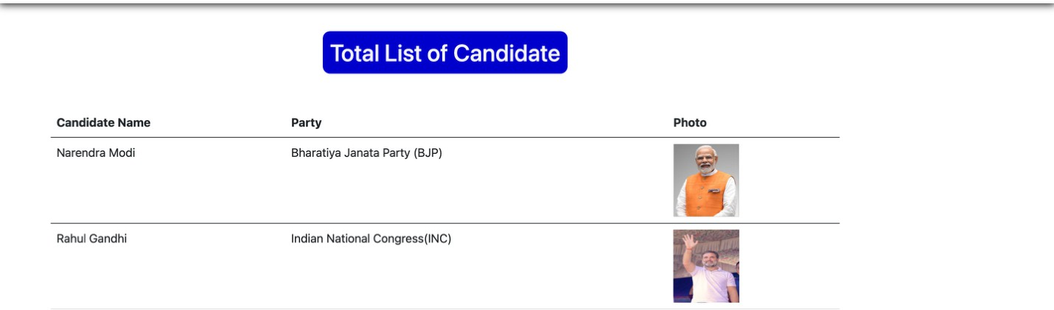
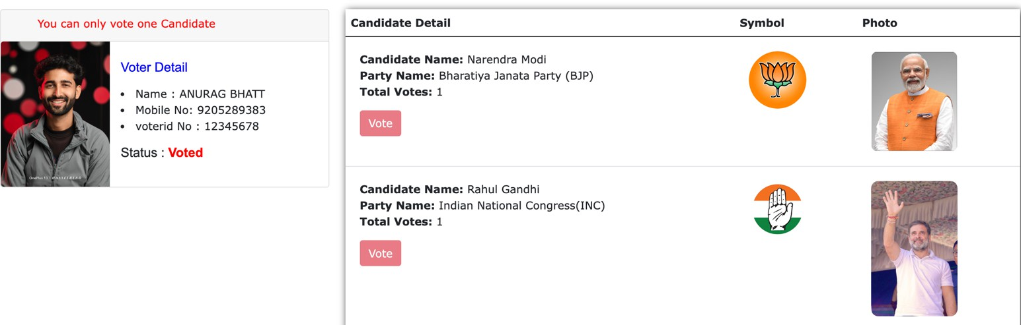
List of candidates:
Total list of candidates will be visible in the Admin Panel
itself
How to Vote:
You can only vote once to any one candidate. Once you have voted
,the vote button will be disabled, just like in the photo.

Slide 22
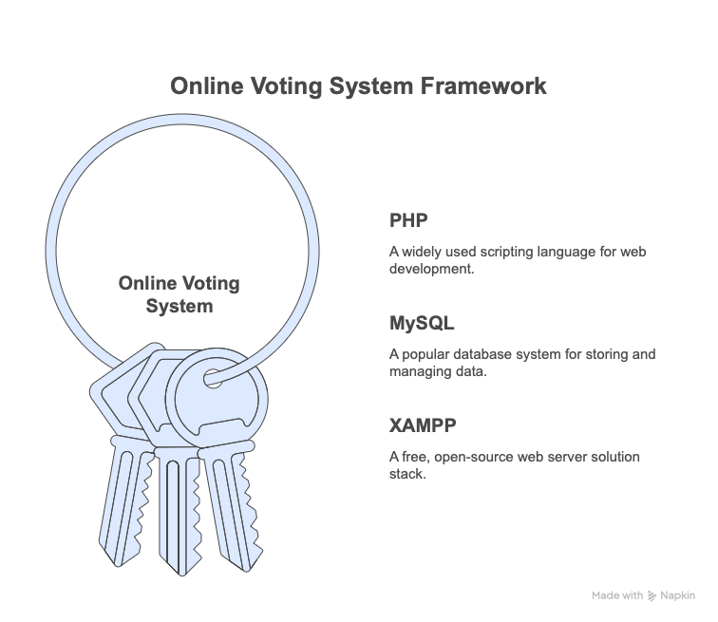
Conclusion
Voters can now cast their ballots online from any location thanks to the Online Voting System, a safe and easy-to-use web application. Numerous drawbacks of conventional voting procedures are addressed by the system, including lengthy lines, manual vote counting, and the inconvenience experienced by residents who live far from their registered addresses.
PHP, MySQL, and XAMPP were used in the construction of this project, providing a solid framework for front-end and back-end functions. Because of its popularity, ease of use, and dependability, MySQL was chosen as the database system
During this trip, I acquired hands-on experience in:
Structuring and implementing a full-stack web application
Applying proper planning and organized methodology
Troubleshooting independently and learning through challenges

Slide 23
References
https://getbootstrap.com
https://developer.wordpress.org/advanced- administration/upgrade/phpmyadmin/
https://developer.mozilla.org/en-US/docs/Web/CSS

